Slide 1
Kubernetes
Sachin Agarwal
www.skillupwithsachin.com

Slide 2
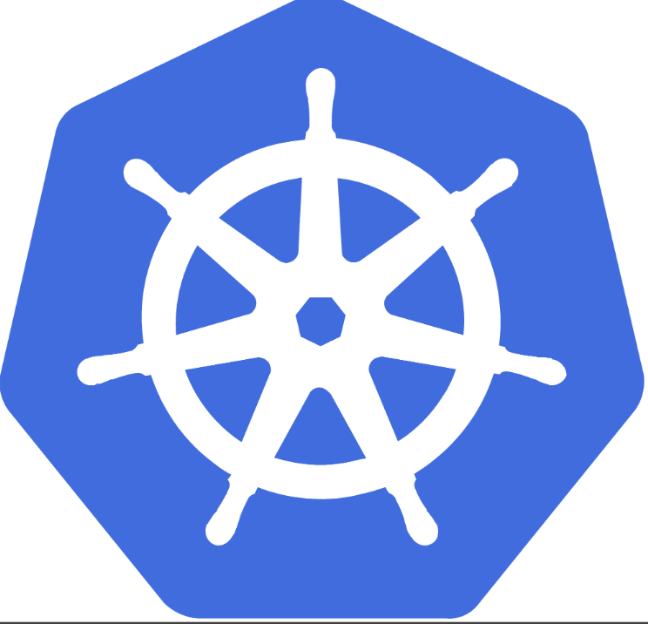
Fun Facts
The name “Kubernetes” comes from the Greek word meaning “helmsman”, a nautical/sailing term for the person who steers a ship.
The wheel of a ship is also called the “helm”, which is obviously where the Kubernetes logo comes from.
Kubernetes logo has 7 spokes instead of the usual 6 or 8. This is because Kubernetes is loosely based on an internal Google tool called “Borg” and the founders wanted to name Kubernetes after the famous Borg drone “Seven of Nine”.

Slide 3
Star Trek Reference
If you’re a Star Trek fan, you’ll know that Seven of Nine is a Borg drone rescued by the crew of USS Voyager under the command of Captain Kathryn Janeway on Stardate 25479. Unfortunately, copyright laws did not permit the use of that name. However, the founders still wanted to pay a tribute to the Borg and Star Trek, so they gave the logo seven spokes in a subtle nod to “Seven of Nine”.

Slide 4
Learn how to set up Kubernetes locally
Docker Desktop
Minikube
K3d
Note: If you’re a Mac user, your single-node Kubernetes cluster will run inside a lightweight VM. If you’re a Windows 10 user, you can enable WSL 2 ( Windows Subsystem for Linux) and have your cluster run natively.

Slide 5
Set Up kubectl Locally
To install on Mac run: brew install kubectl
Powershell: Install-Script -Name 'install-kubectl' -Scope CurrentUser -Force
install-kubectl.ps1 -DownloadLocation C:\Users\nigel\bin
kubectl version --client -o yaml
WIndows 10: choco install kubernetes-cli
kubectl version --client -o yaml

Slide 6
How microservices are different from monolithic applications
What are microservices?
What is cloud-native?
What is an orchestrator?
Before you can understand what microservices are, you will need to look at the traditional way of building applications.

Slide 7
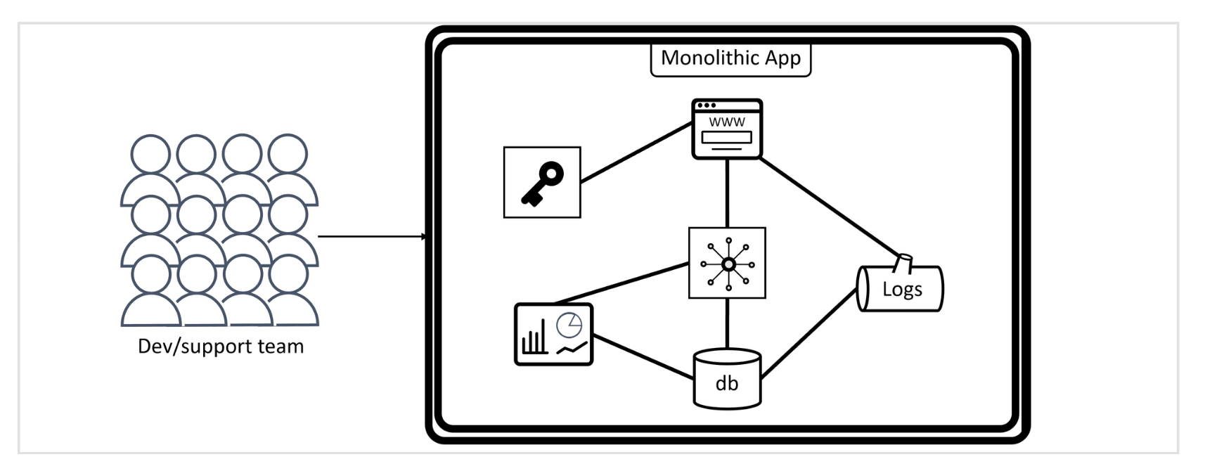
Monolithic Applications

Slide 8
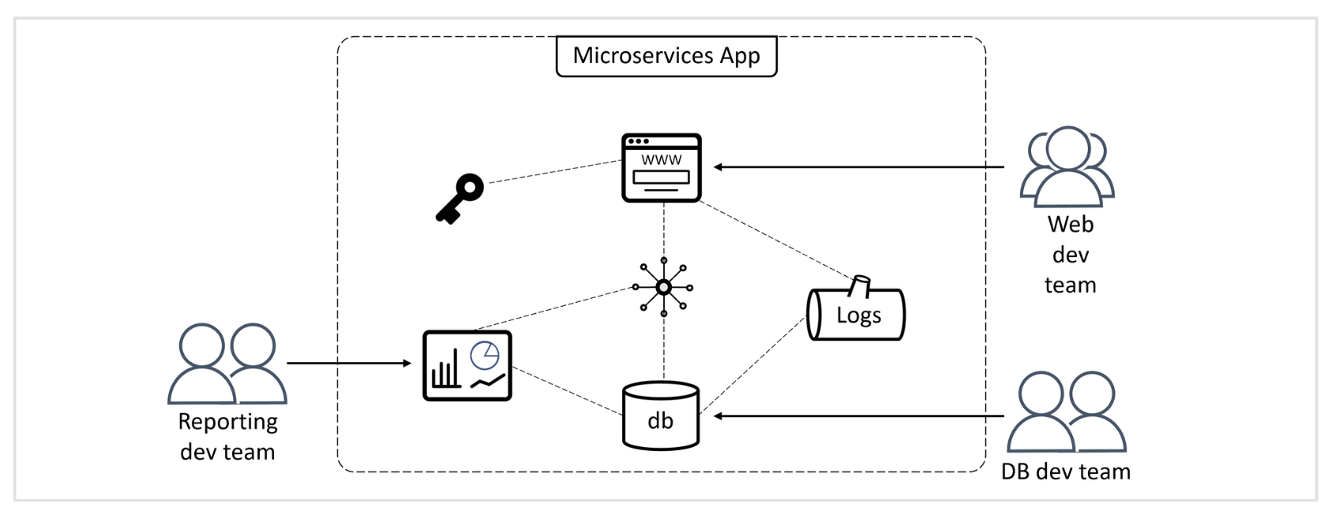
Microservices Applications

Slide 9
Cloud Native Applications
A cloud-native application must :
Scale on demand
Self-heal
Support zero-downtime rolling updates
Run anywhere that has Kubernetes

Slide 10
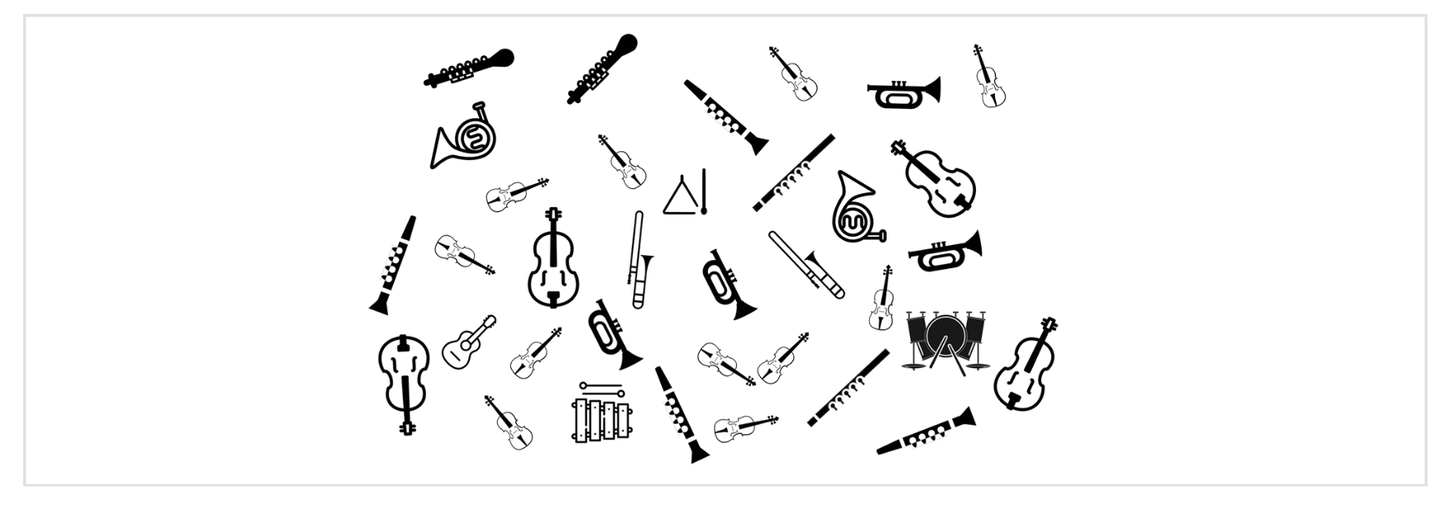
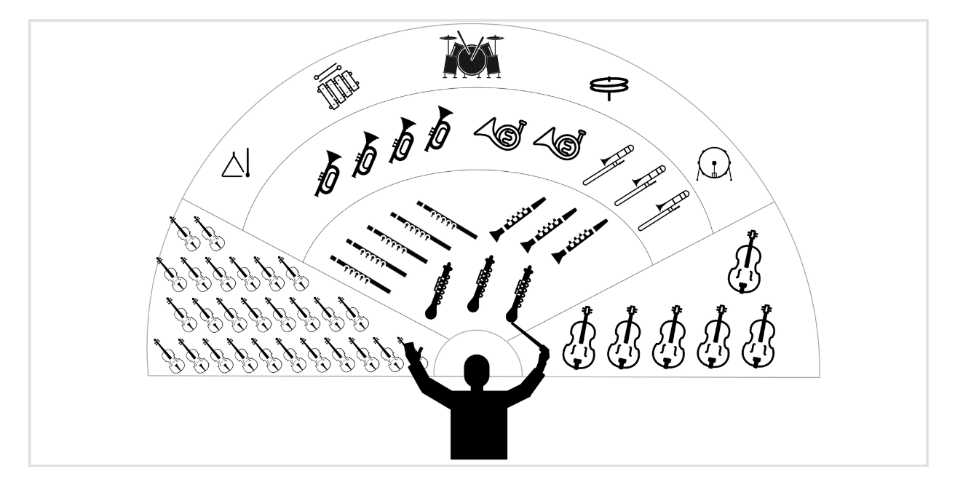
What is an Orchestrator ?
Orchestra
Conductor

Slide 11
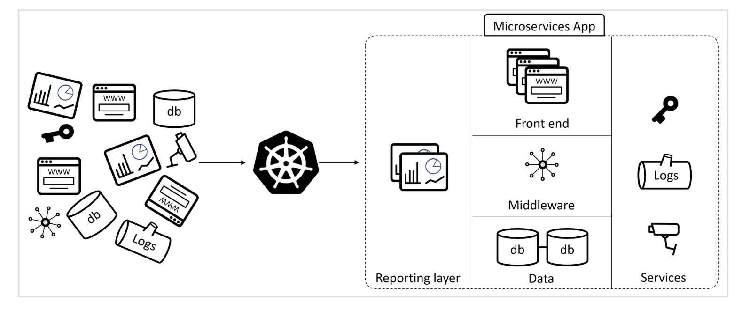
Kubernetes (in Layman)

Slide 12
Kubernetes Architecture
Master and Worker Nodes
Masters host the control plane. That is a fancy way of referring to the brains of the cluster.
Recommended to maintain Master in HA
Master has following components:
API Server
Scheduler
ETCD
Controllers

Slide 13
ComponentsOverview
API Server: This is the part that you directly interact with. When you send commands to the cluster, they go to the API server and responses come from the API server.
Scheduler :: The Scheduler chooses which nodes to run the user applications on.
ETCD: This is the store/ database where the state of cluster and all applications are stored.
Controller: The controller allows Kubernetes to integrate with cloud services, such as storage and load-balancers

Slide 14
Nodes: Nodes run user applications and can either be Linux or Windows Nodes. It has two main services, Kubelet and Container Runtime
Kubelet : This is main K8’s agent which joins node to the cluster and communicates with control plane, in charge of notifying when tasks are received and reporting on status of those tasks.
Container RunTime : This starts and stops containers.

Slide 15
Do you know ?
In the past, Kubernetes would use docker as its container runtime. However, Kubernetes 1.20 announced that support for the Docker container runtime would be dropped in a future release of Kubernetes. Although Kubernetes will stop supporting Docker as a runtime, it will continue to support images created by Docker. In fact, Docker and Kubernetes both conform to the Open Container Initiative (OCI) standards for container images. In other words,container images created by Docker are 100% compatible with Kubernetes.

Slide 16
Architecture Flow
Resource Definition: A user defines a desired state (e.g., a Deployment) using YAML/JSON manifests.
API Server: Processes the request and updates etcd.
Scheduler: Assigns pods to suitable nodes based on resource constraints.
Kubelet: Ensures pods are created and containers are running on the assigned nodes.
Controller Manager: Continuously monitors resources to maintain the desired state.
Kube Proxy: Manages networking and ensures service-to-pod communication.

